Slide 1

BOA Analysis
By Onwupelu miracle

Slide 2
INTRODUCTION
Bank of America (BoA), a U.S.-based financial institution, has amassed many customer complaints throughout the years. To tackle this, BoA has chosen to examine consumer grievances concerning its financial offerings from 2017 to 2023. A detailed dataset has been provided, which included up-to-date information about every complaint, such as submission and receipt dates, related products and issues, and the responses from BoA. The BoA invites analysts and policymakers to examine the dataset to reveal insights and formulate strategies for responding to customer complaints more efficiently.

Slide 3
OBJECTIVE
The primary aim of this report is to analyze the data, identify patterns, and propose informed, data-driven recommendations that BoA can implement to effectively address and reduce customer complaints.

Slide 4
Stories help you control the narrative. They guide your audience through your analysis, step by step.”
DATA METHODOLOGY
The dataset was cleaned with python, duplicates were eliminated, null values were removed and analysis were carried out with python using its libraries
A dashboard is where you bring multiple worksheets together. Instead of showing one chart, you’re now telling a complete story across several visuals.

Slide 5
KEY INSIGHTS AT A GLANCE(KPIs)
62,516
Complaints
01
51
Total States
03
7
Complaint Submission channel
02
9
Products
04
76
Issues

Slide 6
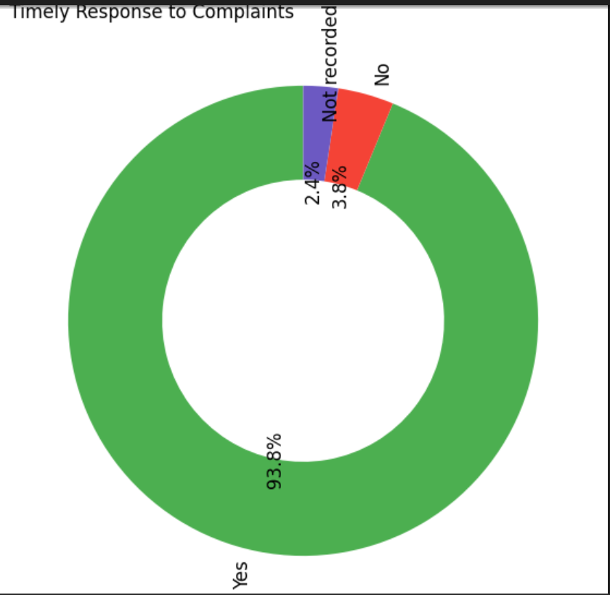
INSIGHTS:
TIMELY RESPONSE ANALYSIS
From the chart, we can see that 93.8% customers received timely response.
This shows that BOA are doing a great job in delivering timely response to customers complaint.

Slide 7
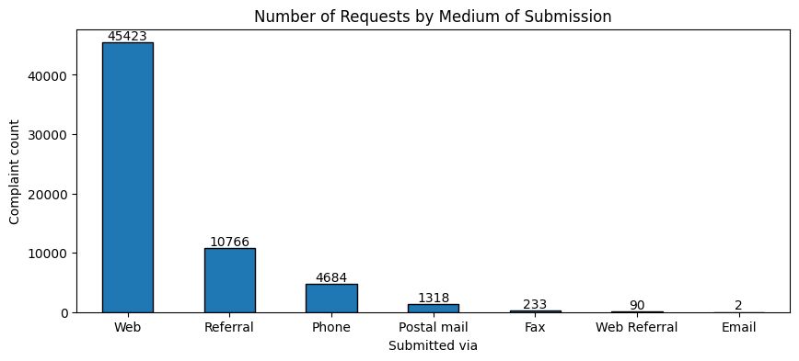
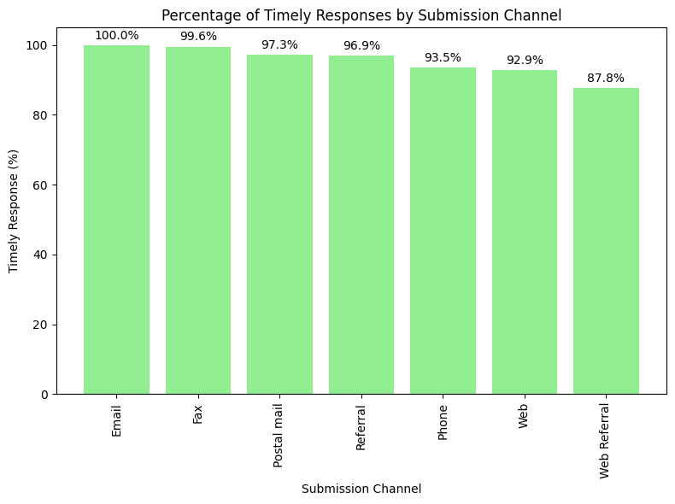
REQUEST CHANEL ANALYSIS
INSIGHTS:
The company received the highest number of complaints via web(45,423) and just very few used email
We can also see that the customers who submitted their complaints via email all received timely response.

Slide 8
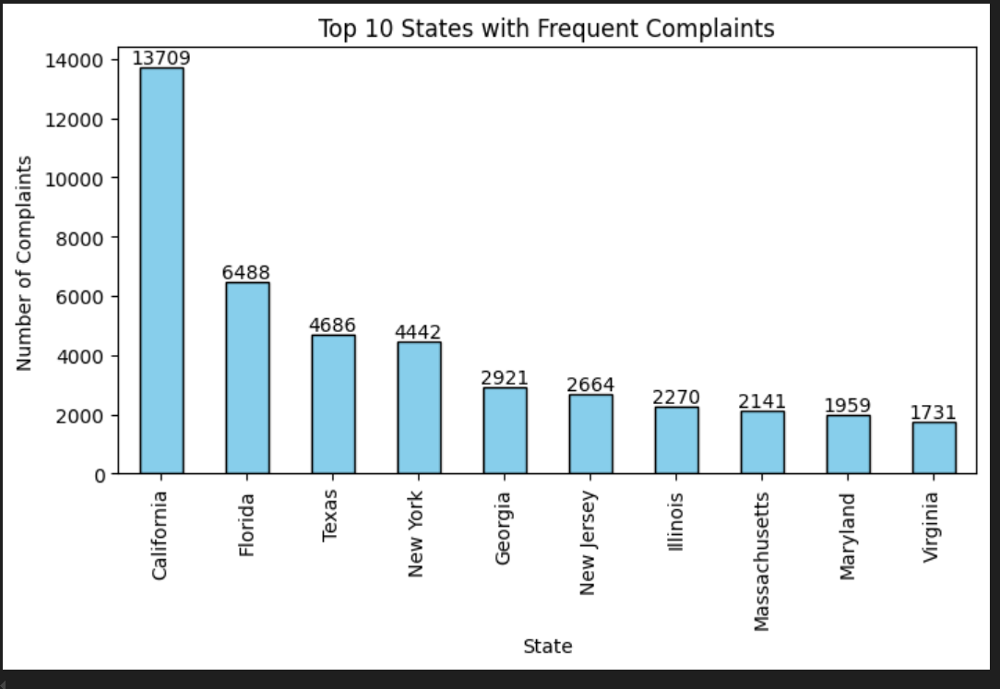
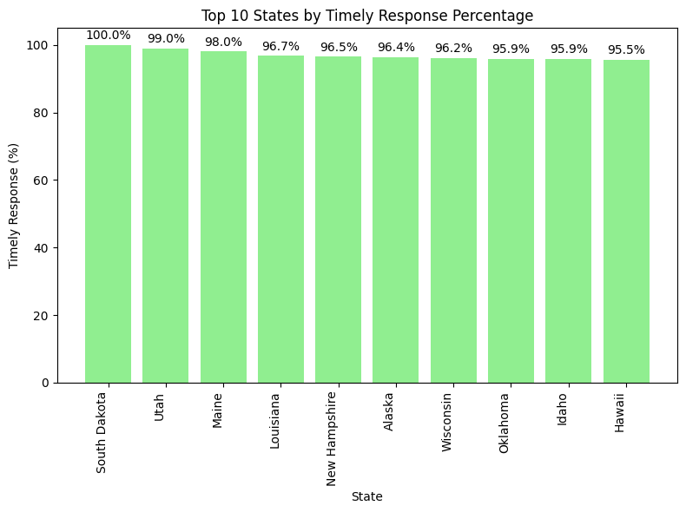
INSIGHTS:
STATE COMPLAIN VOLUME AND TIMELY RESPONSE RATES
The Company received the highest number of complaints from California(13,709) and this could probably be due to the population at California
The Customers in South Dakota received all timely response to their complaints this could probably be because they used the most effective Submission channel and their low population density.

Slide 9
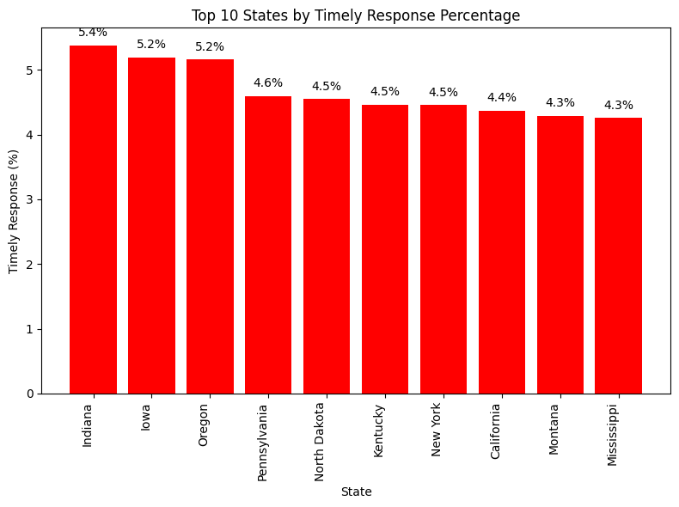
The Customers in Indiana had the highest number of people who received least timely response and it’s not that they didn’t get timely response but about 5.4% of the Customers from Indiana did not receive timely response.

Slide 10
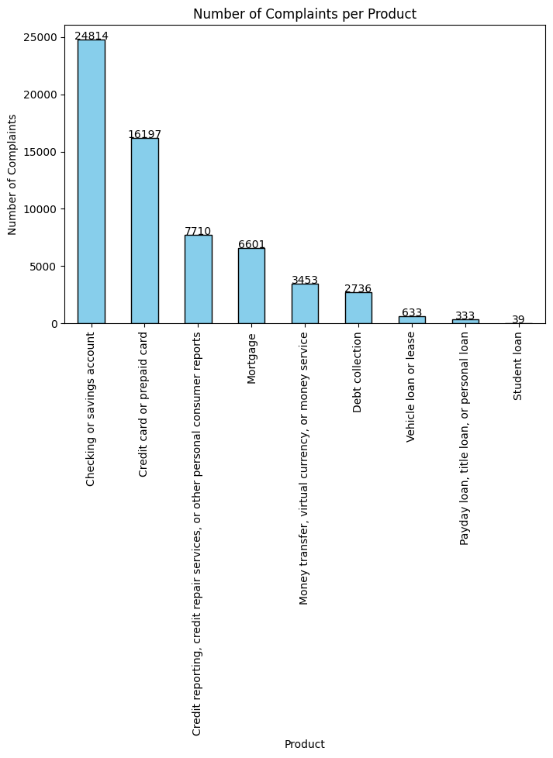
INSIGHTS:
PRODUCT ANALYSIS
The Bank received the highest number of complaints from customers who used saving account(24,814)
The Customers faced issues with the banks products and services, savings account, checking their account and certificate of deposit

Slide 11
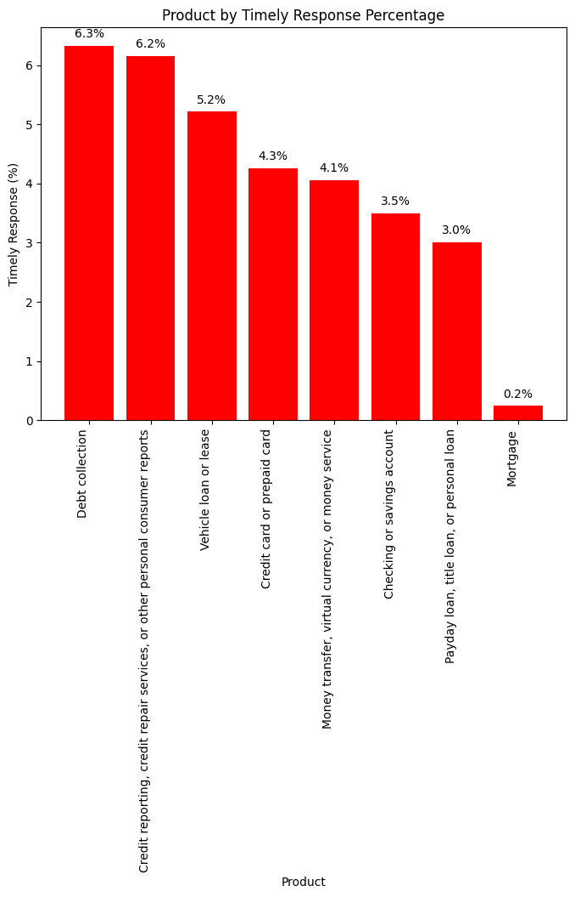
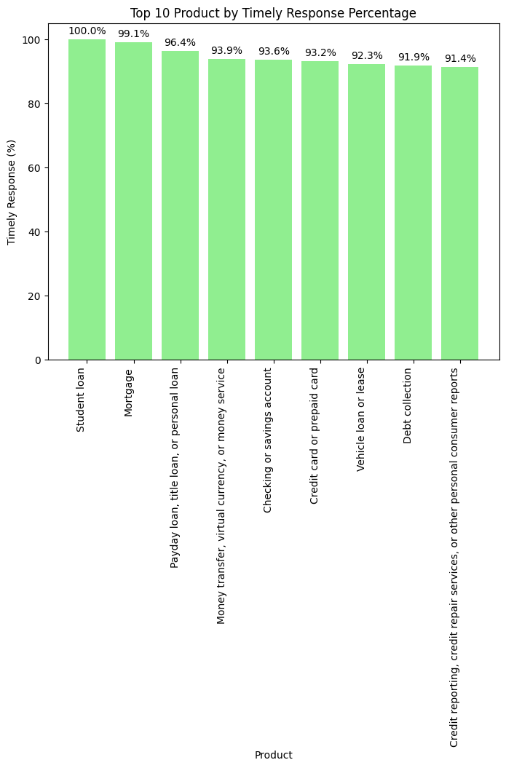
For services which involved taking loan by students they received all timely response
For services which involved debt collection they have the least timely response rate.

Slide 12
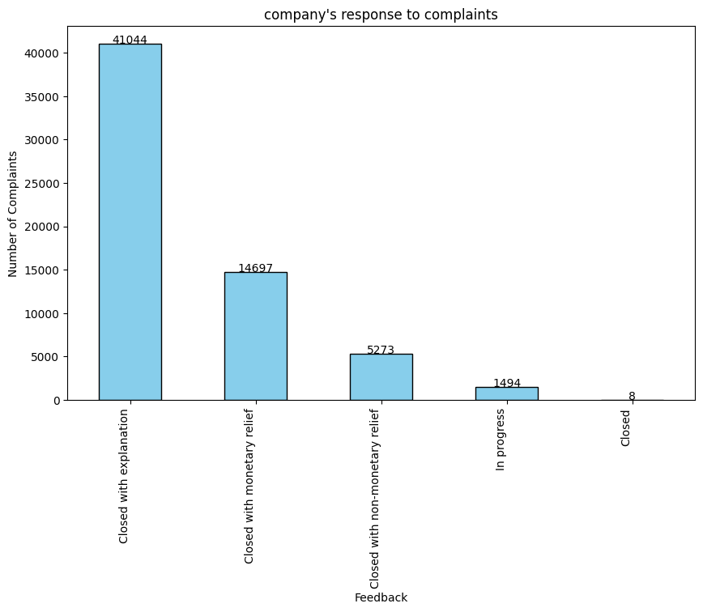
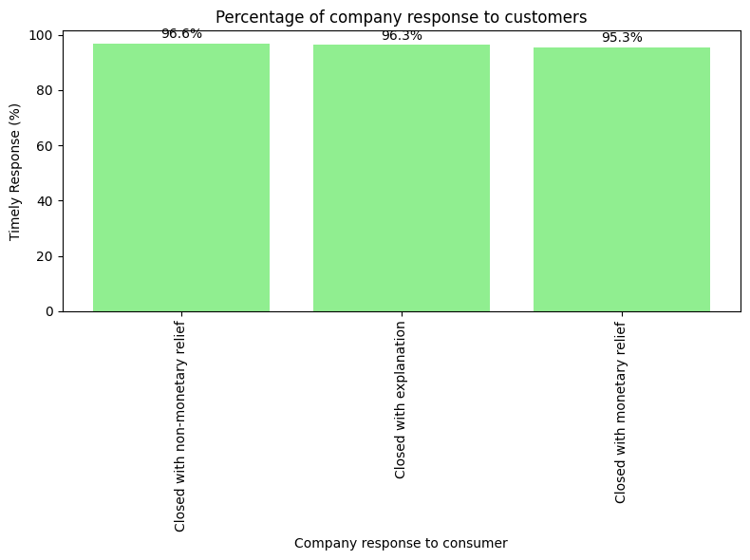
INSIGHTS:
Company’s response to complaints
The company’s response to most of the complaints from customers was to ‘close with explanation’ but whenever they responded to complaints by ‘closing with non monetary’relief they provide better timely response

Slide 13
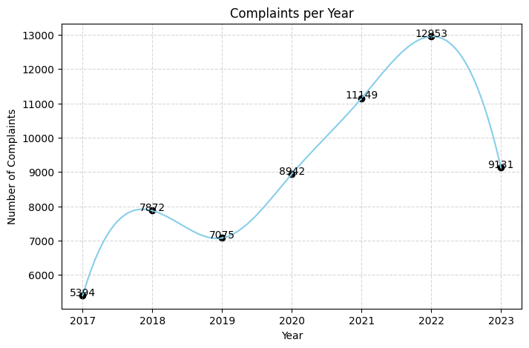
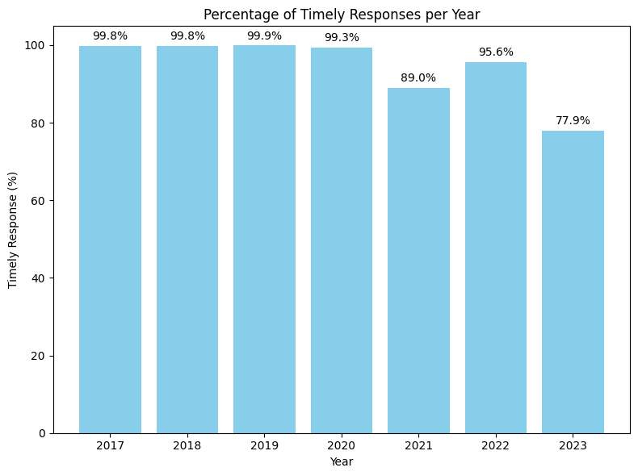
INSIGHTS:
YEAR ANALYSIS
The bank received the highest number of complaints in the year 2022(12,953) and provided better timely response to its customers in the year 2019.

Slide 14
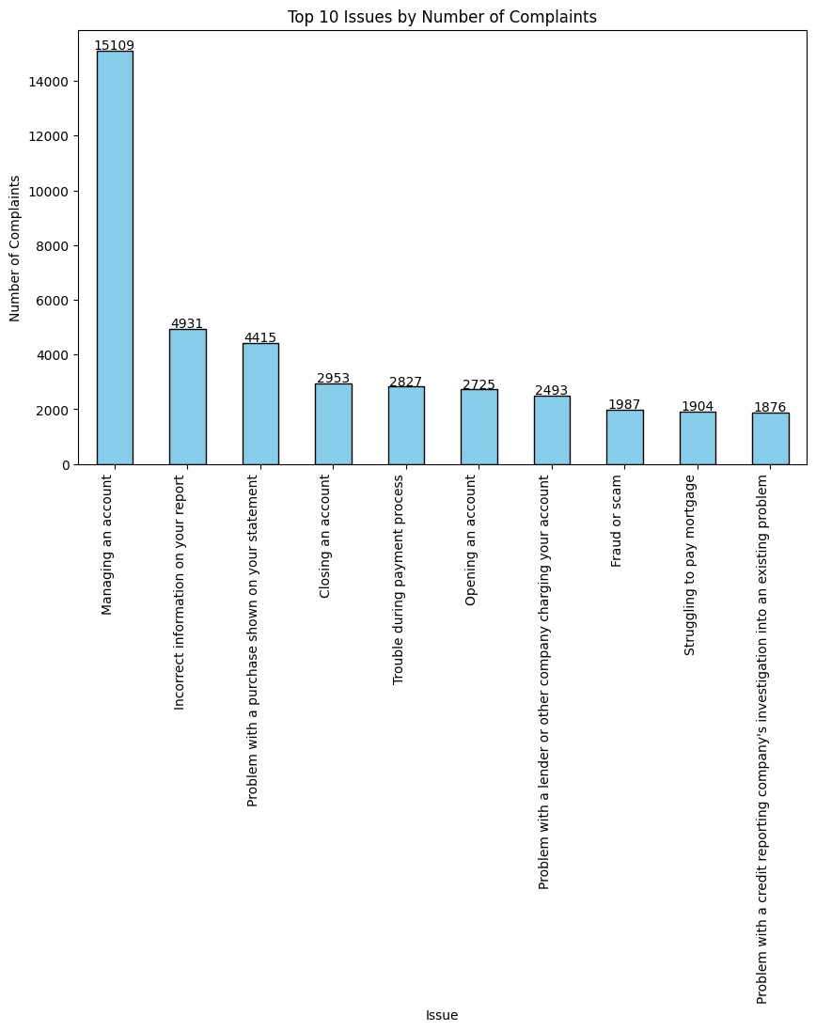
INSIGHTS:
ISSUE ANALYSIS

Slide 15
Common issues due to the main issue of Managing their account
Banking issues
Cashing a cheque
Deposits & Withdrawals
Fee Problem
Problem accessing account
Problem making or receiving payment
Problem using a debit or ATM card
Problem with renewal

Slide 16
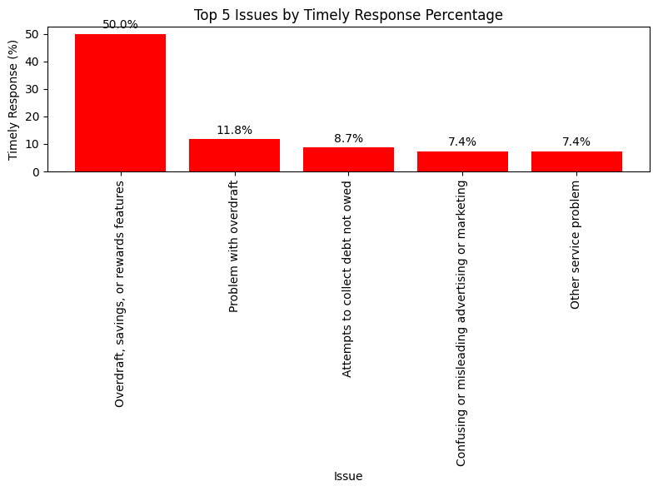
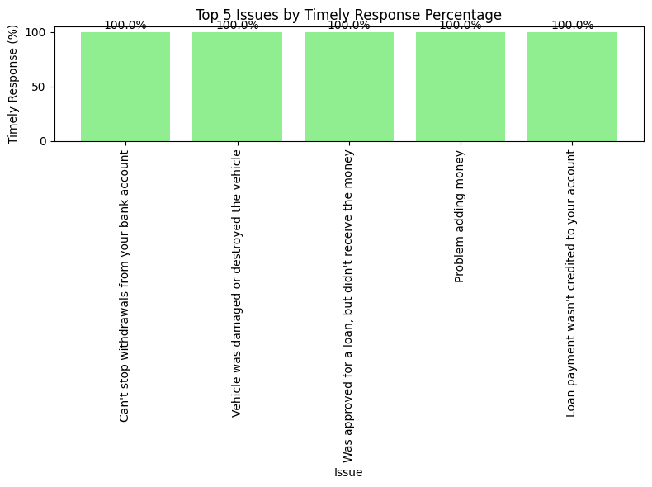
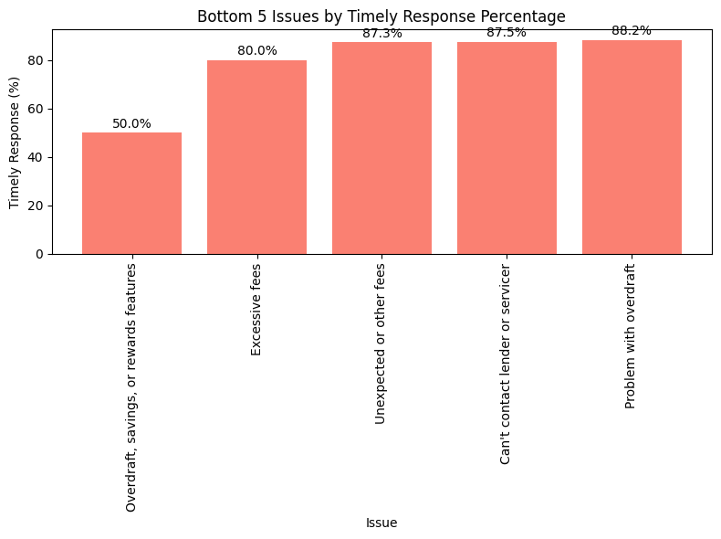

Slide 17
RECOMMENDATIONS
01
02
03
Account Management Issues (61%) → Improve app interface, usability, and add support features to reduce frustration.
Monetary Relief Cases → Streamline and prioritize handling to boost satisfaction.
Geographic Focus → California has the highest complaints; prioritize localized customer support.
04
05
06
Self-Service Resources → Provide guides and tools for common account issues to reduce minor complaints.
Transparency → Offer public responses when closing complaints to show accountability.
Proactive Support → Use predictive tools to anticipate and prevent recurring issues.

Slide 18
CONCLUSION
This analysis provides valuable insights into Bank of America customer complaints, operational efficiency, and their response to complaints. Data-driven decision-making is essential for stakeholders to improve performance and maintain a competitive edge in the Financial services world.

